Slide 1

Hackathon
Get
Connected
崔天一，何宪航，庄思源
Internet of things
Based on Project Oxford

Slide 2

What we did
ONE
TWO
THREE
FOUR
Our ideas
Our tools
Hacking!
Presentation
What if we connect things together?
Inspiration
Talk is cheap
Show me the code
How?
lol

Slide 3
1
Our ideas

Slide 4
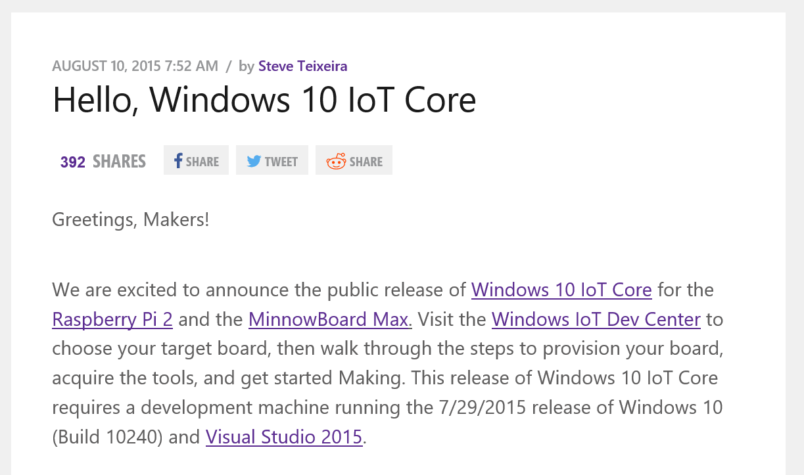
物联网/基于树莓派
Aug 10, 2015
Windows IoT core public release

Slide 5
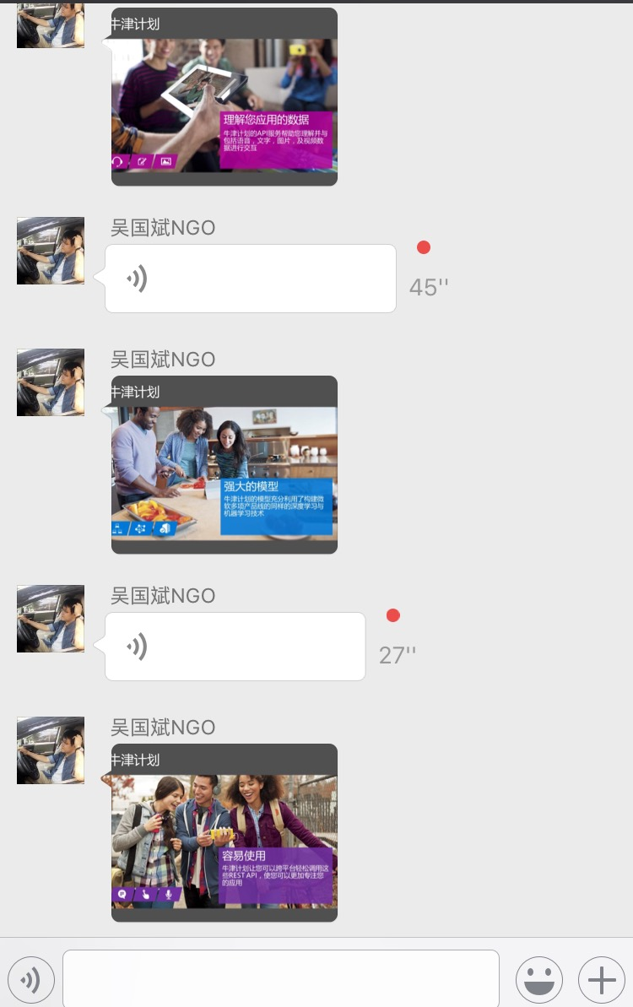
40%
受到MSC线上微课启发

Slide 6
2
Our tools

Slide 7






1
2
3
Project
Oxford
Computer Vision APIs
Face APIs
Emotion APIs
微软牛津计划 提供了一组基于Rest架构的API和SDK工具包，帮助开发者轻松使用微软的自然数据理解能力为自己的解决方案增加智能服务。
4
5
6
Speech APIs
LUIS
Spell Check APIs

Slide 8
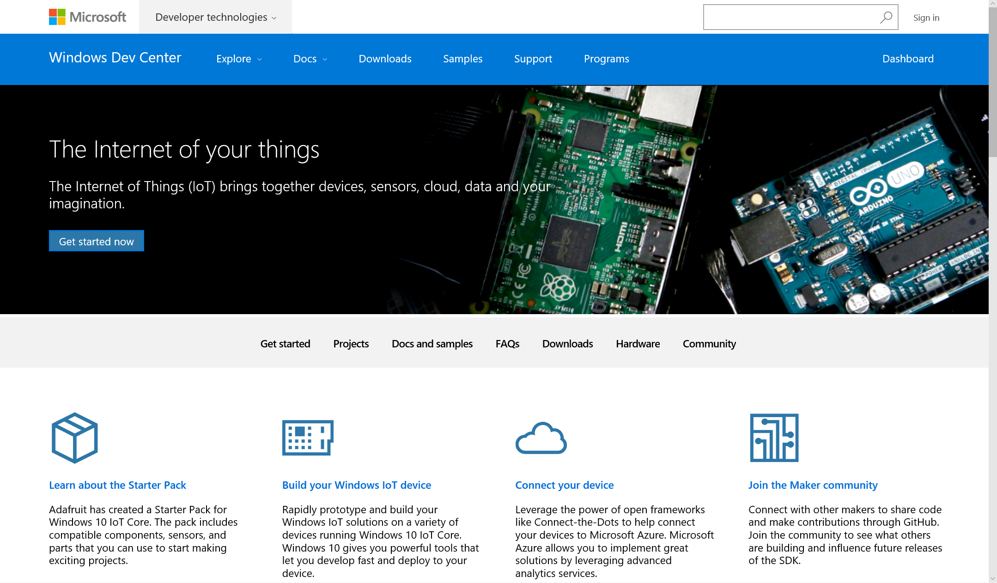
IoT based on Raspberry Pi

Slide 9
3
Hacking!

Slide 10
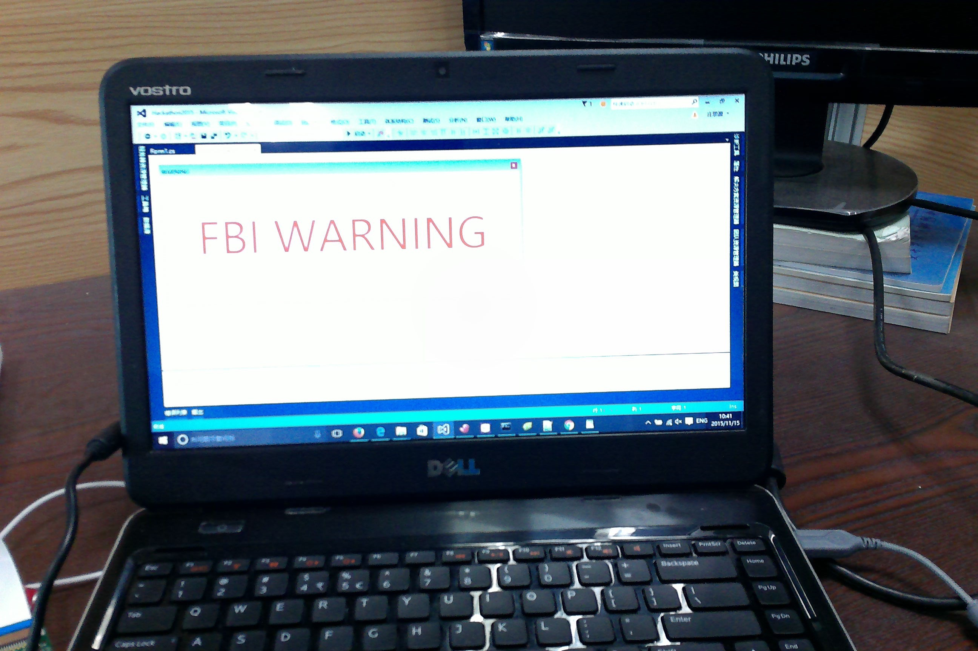
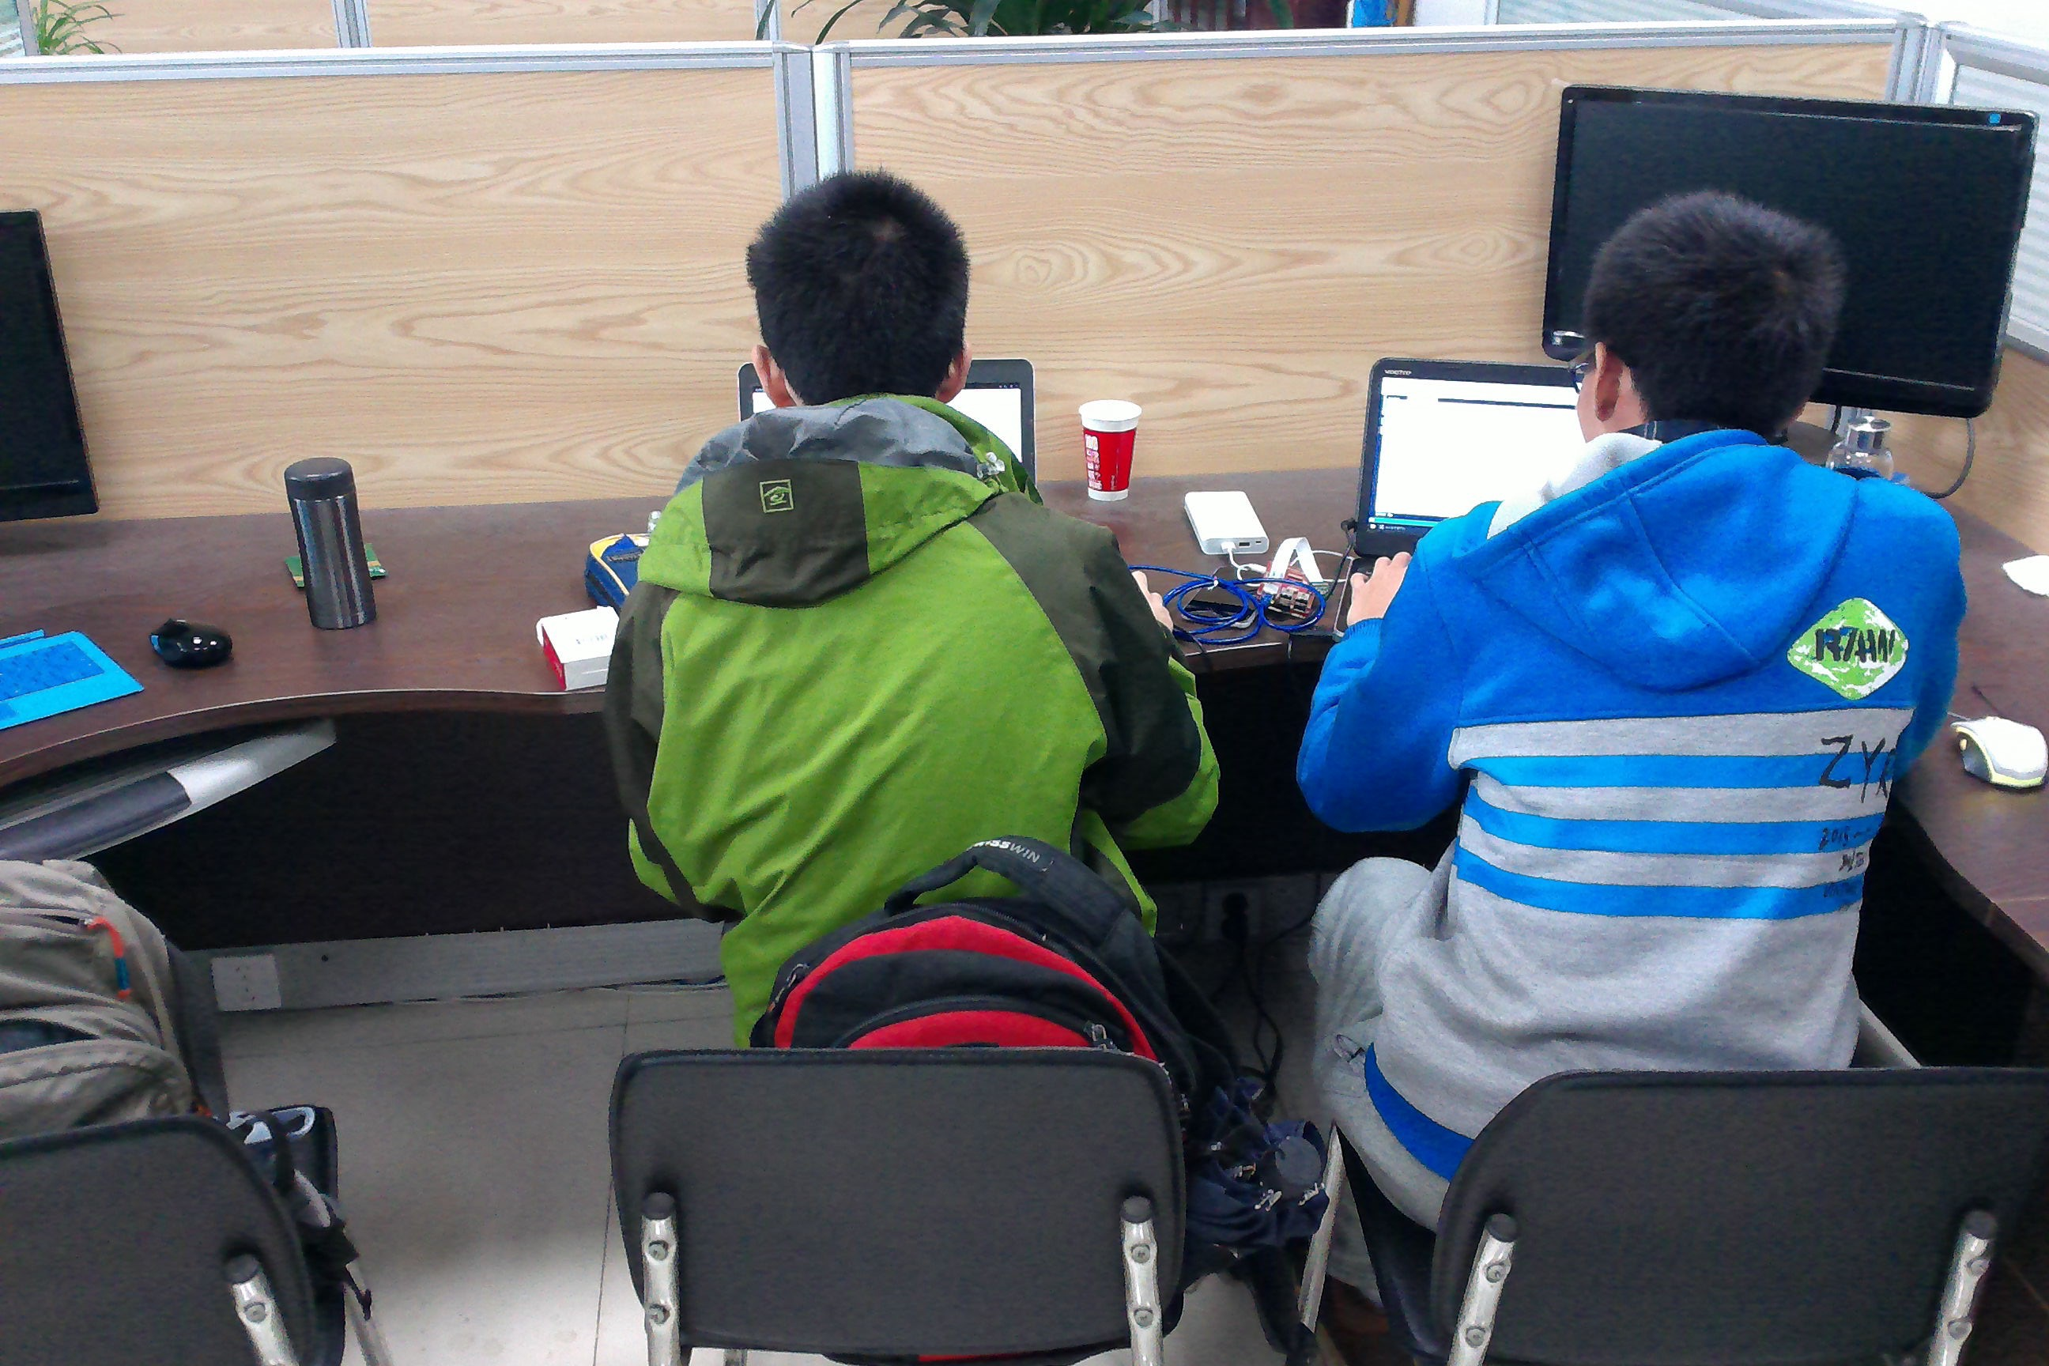
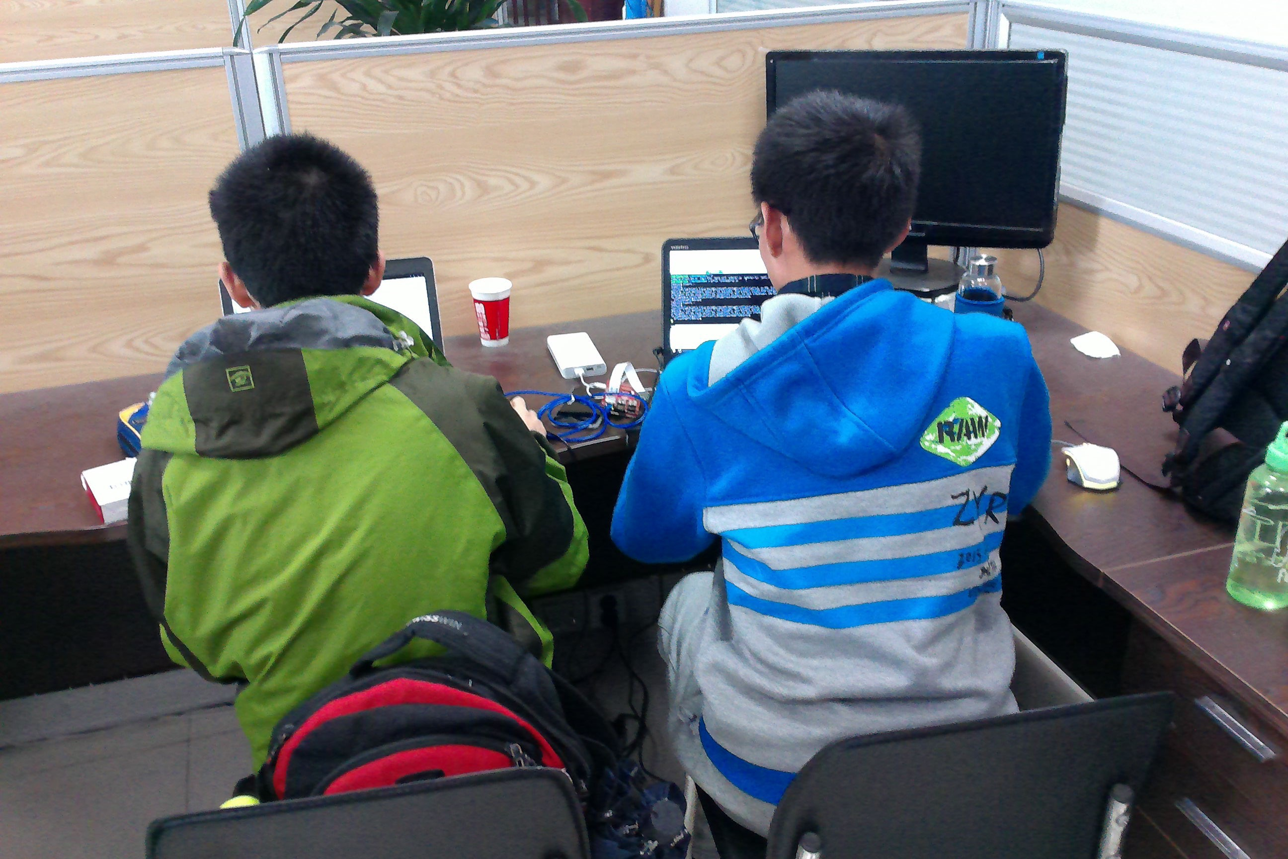
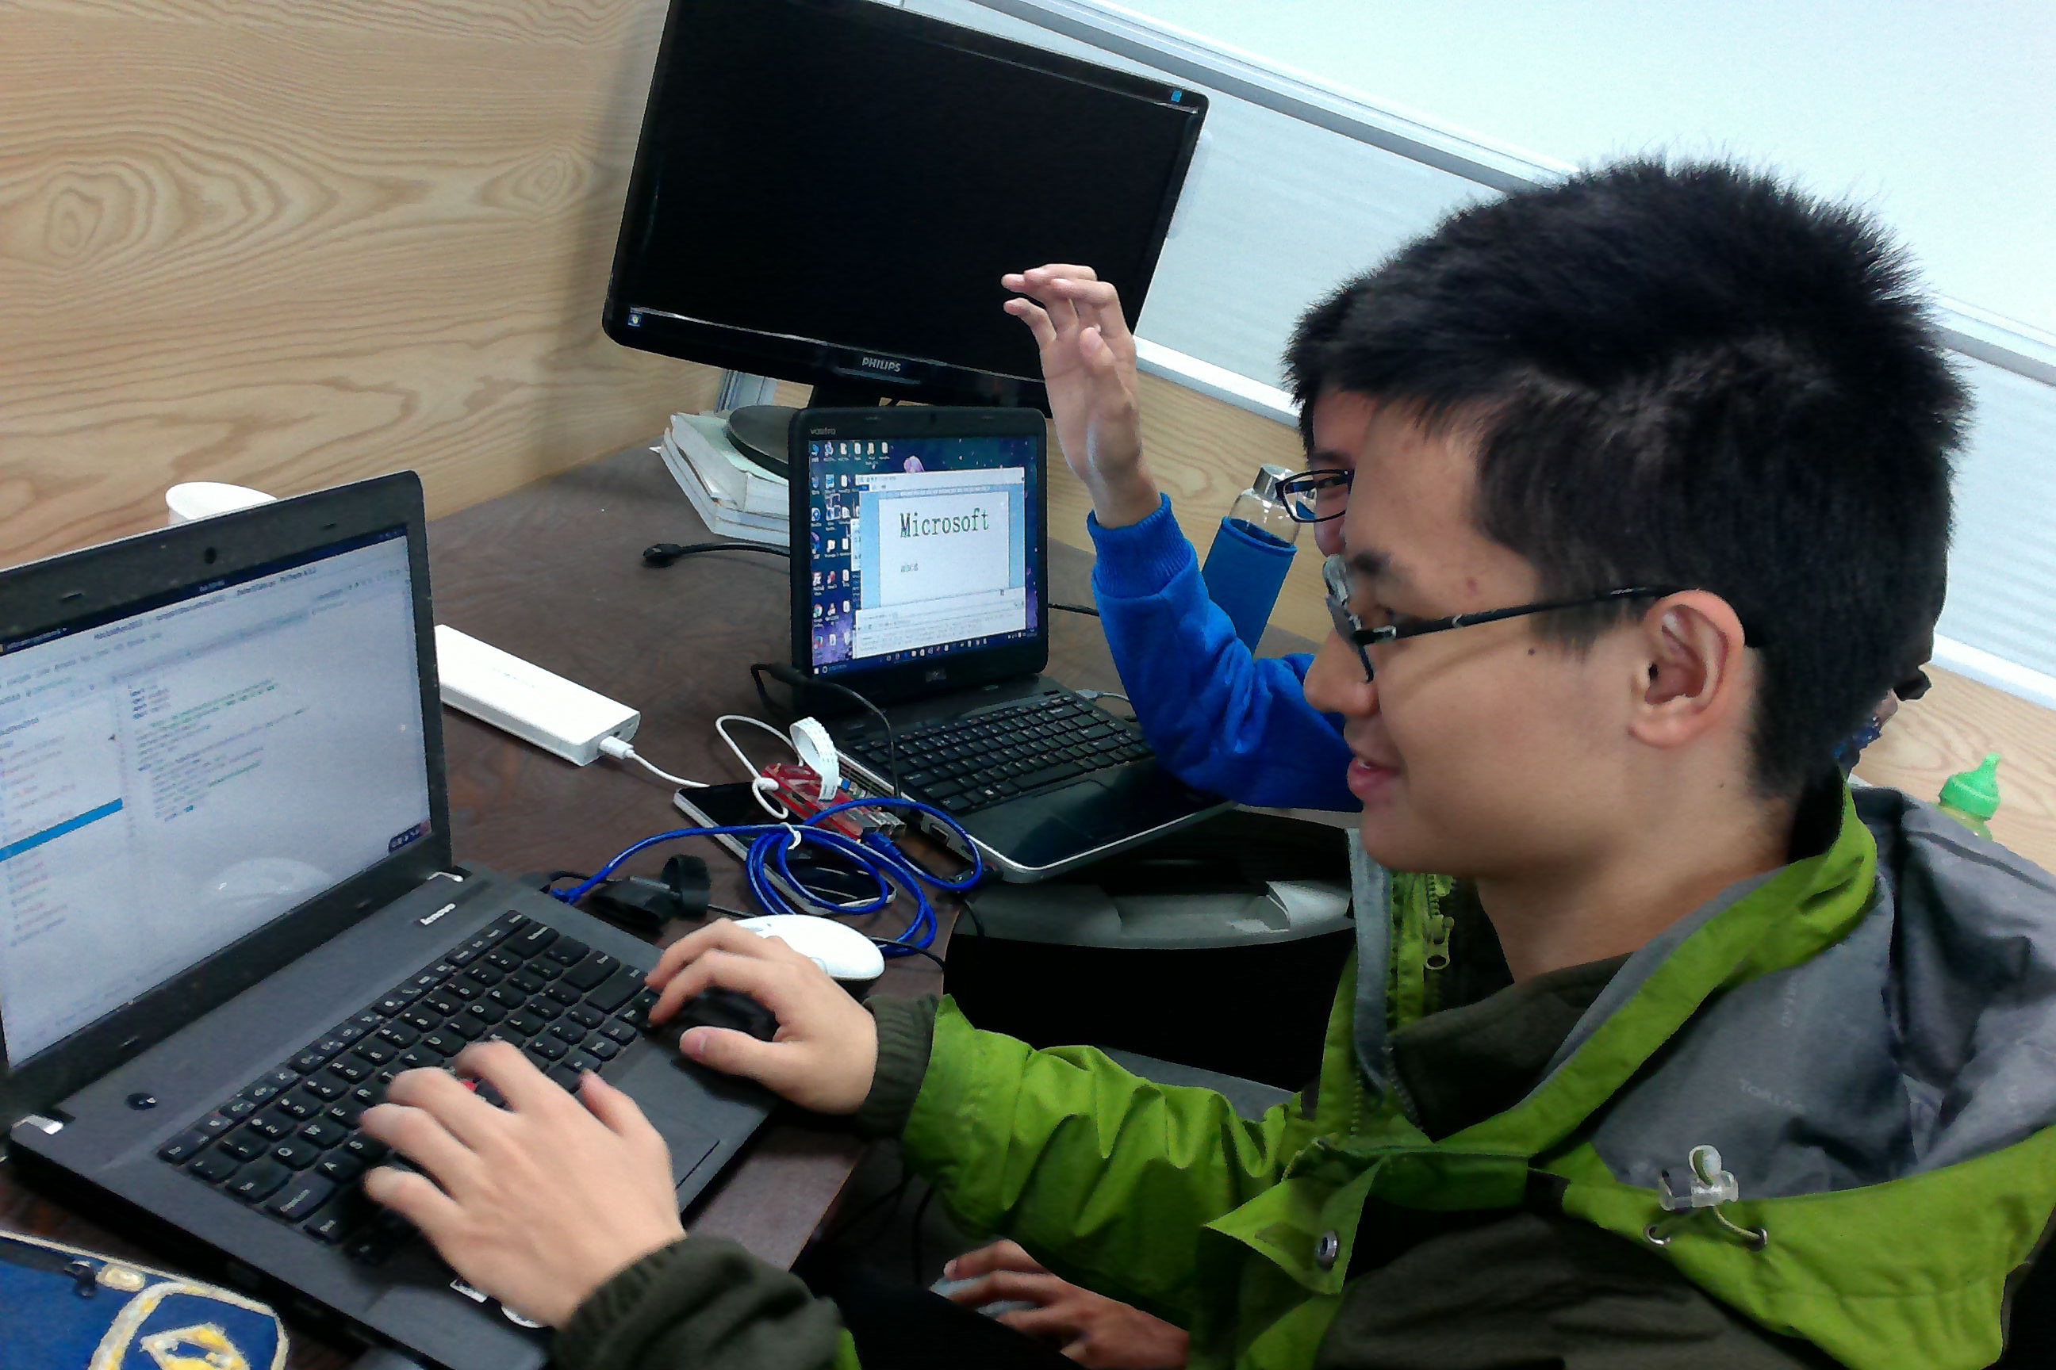

Slide 11
4
Presentation

Slide 12
Behold…
IoT Spy
Refrigerator Guarder
Raspberry with camera
Take Photo if accent color changed (w /Computer Vision API)
Detect face in the photo(w/ Face API)
Life Automation
Based on OCR service (w /Computer Vision API)

Slide 13
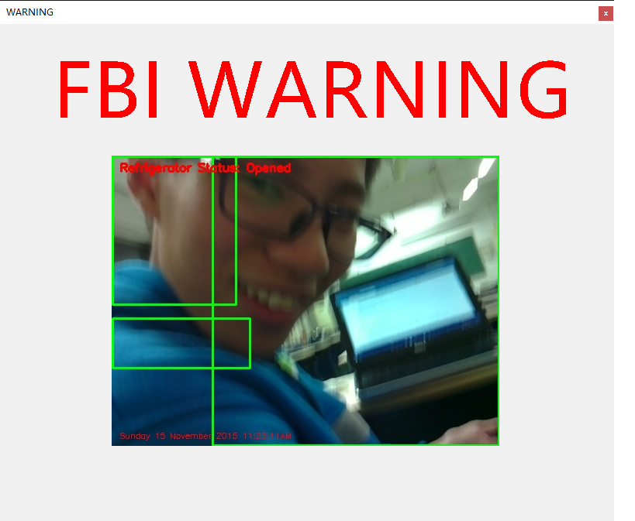
树莓派作为服务端
检测背景变化（基于Computer Vision API & OpenCV）
上传拍摄照片，调用Face API检测年龄性别等特征
向PC客户端发出警告
客户端弹窗提醒

Slide 14
That’s how
we hack it!
THANK YOU!
崔天一，何宪航，庄思源
Internet of things
Based on Project Oxford
For the newest version plz visit github.com/suquark

